Slide 1
ADO.NET
Asma Kanwal
Lecturer
Department of Computer Science
GC University, Lahore

Slide 2
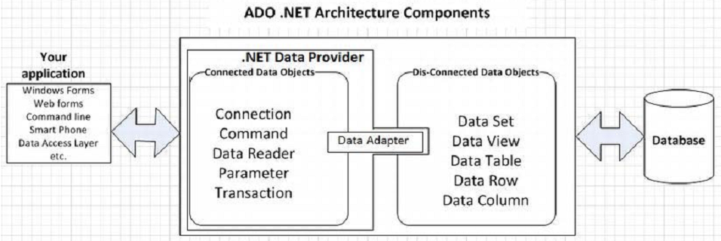
ADO.NET Architecture

Slide 3
Connected Data Objects
Connection: This is the main, or core, object for any database-oriented application. Each .NET provider provides its own Connection object that offers features targeted to specific data sources.
Command: This object represents the handling of statements that your application will be using to perform data-oriented tasks, such as reading data or inserting or modifying data. Hence, any SQL statement is actually executed via a Command Object.
DataReader: DataReader involves creating an instance of the Command object and then creating a DataReader by calling Command.ExecuteReader for data retrieval from your data source, the returned data can be fetched in a read-only way through a DataReader object.

Slide 4
Connected Data Objects
Parameter: A Parameter can be a value passed or returned to/from a stored procedure or an argument passed to a SQL query.
DataAdapter: DataAdapter is the object ADO.NET exposes to bridge the gap between connected and disconnected architectures to let applications establish a connection and sync data into and from the data source.

Slide 5
Disconnected Data Objects
DataSet: A data set can be considered a subset of data. A data set supports disconnected, independent caching of data in a relational fashion, updating the data source as required. A data set contains one or more data tables.
DataTable: DataTable is a row-and-column representation that provides much the same logical view as a physical table in a database.
DataRow: ADO.NET’s DataTable consists of rows of the DataRowCollection type. When new data is added to the DataTable, a new DataRow is added.

Slide 6
Disconnected Data Objects
DataColumn: ADO.NET’s DataTable consists of a DataColumn of the DataColumnCollection type.
DataView: DataView in ADO.NET serves a purpose similar to a view in a database. Usually a view in a databse provides a predefined, organized, or filtered set of records. Similarly, a DataView provides filtered or sorted records from a DataTable.

Slide 7
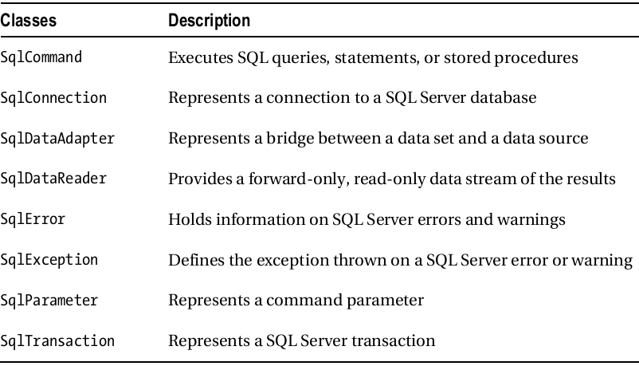
sqlClient Classes

